Slide 1
8086 Interrupts
8086 Interrupts and Interrupt responses
8086 Interrupt types
8259A Priority Interrupt Controller – 8259A overview and system connections and cascading
Initializing an 8259A including Initialization Command Words (ICW) and Operational Command Words (OCW). (Refer Text Book 2).

Slide 2
8086 Interrupts
and
Interrupt Applications

Slide 3
8086 Interrupts and Interrupt Responses
The meaning of ‘interrupts’ is to break the sequence of operation
While the CPU is executing a program, an interrupt breaks the normal sequence of execution of instructions, diverts its execution to some other program called Interrupt Service Routine (ISR)
After executing ISR , the control is transferred back again to the main program

Slide 4
An 8086 interrupt can come from any one of the three sources
One source is an external signal applied to the Non Maskable Interrupt (NMI) input pin or to the Interrupt (INTR) input pin
An interrupt caused by a signal applied to one of these inputs is referred to as a hardware interrupt

Slide 5
A second source of an interrupt is execution of the Interrupt instruction, INT
This is referred to as Software Interrupt
The third source of an interrupt is some error condition produced in the 8086 by the execution of an instruction
An example of this is the divide by zero error

Slide 6
ISR procedure
PUSH registers
-
-
-
POP registers
Mainline Program
PUSH Flags
CLEAR IF , TF
PUSH CS
PUSH IP
FETCH ISR ADDRESS
POP IP
POP CS
POP FLAGS
IRET

Slide 7
It decrements SP by 2 and pushes the flag register on the stack
Disables INTR by clearing the IF
It resets the TF in the flag Register
It decrements SP by 2 and pushes CS on the stack

Slide 8
5. It decrements SP by 2 and pushes IP on the stack
6. Fetch the ISR address from the interrupt vector table

Slide 9
03FFH
Type 255 (Available)
03FCH
Available Interrupts
(224)
080H
Type 32 (Available)
Type 31 (Reserved)
07FH
Reserved Interrupts (27)
0014H
Type 5
Reserved

Slide 10
Type 4 POINTER
(OVERFLOW)
010H
Type 3 POINTER
(BREAK POINT)
00CH
Type 2 POINTER
(NON-MASKABLE)
008H
Type 1 POINTER
(SINGLE STEP)
004H
Type 0 POINTER
(DIVIDE ERROR)
000H
CS base address
IP offset

Slide 11
Interrupt Vector Table
INT Number Physical Address
INT 00 00000
INT 01 00004
INT 02 00008
: :
: :
INT FF 003FC

Slide 12
Example
Find the physical address in the interrupt vector table associated with
INT 12H b) INT 8H
Solution: a) 12H * 4 = 48H
Physical Address: 00048H ( 48 through 4BH are set aside for CS & IP)
b) 8 * 4 = 20H
Memory Address : 00020H

Slide 13
Difference between INT and CALL instructions..
S.No | CALL | INT
1. | Can Jump to any location with in 1MB address range | Goes to fixed memory location in the interrupt vector table to get address of ISR
2. | Used by the programmer in the sequence of instructions in the program | Externally activated hardware interrupt can come at any time

Slide 14
S.No | CALL | INT
3. | Cannot be masked (disabled) | INTR can be masked
4. | Automatically saves CS: IP of next instruction | In addition to CS:IP, Flags can be saved
5. | RET is the last instruction | IRET to pops of F, CS:IP

Slide 15
8086 Interrupt Types…

Slide 16
Divide-by-Zero Interrupt – Type 0
INT 00 is invoked by the microprocessor whenever there is an attempt to divide a number by zero
When it does a type 0 interrupt, the 8086 will push the flags on the stack, reset TF and IF, and push the CS value and the IP value for the next instruction on the stack
ISR is responsible for displaying the message “Divide Error” on the screen

Slide 17
Ex1: Mov AL,82H ;AL= 82
SUB CL,CL ;CL=00
DIV CL ;82/0 = undefined result
EX2: Mov AX,0 FFFFH; AX = FFFFH
Mov BL,2 ; BL=02
DIV BL ; 65,535/2 = 32767 larger than 255 maximum capacity of AL

Slide 18
Single-Step Interrupt – Type 1
In single-step mode, a system will stop after it executes each instruction and wait for further direction from us
The 8086 trap flag and type 1 interrupt response make it quite easy to implement a single-step feature in an 8086 based system

Slide 19
For single stepping the trap flag must be set to 1
When it does a type 1 interrupt, the 8086 will push the flags on the stack, reset TF and IF, and push the CS value and the IP value for the next instruction on the stack
After execution of each instruction, 8086 automatically jumps to 00004H to fetch 4 bytes for CS: IP of the ISR
The job of ISR is to dump the registers on to the screen

Slide 20
The 8086 has no instruction to directly set or reset the trap flag
These operations are done by pushing the flag register on the stack, changing the trap flag bit to what you want it to be, and then popping the flag register back off the stack

Slide 21
Here is the instruction sequence to set the trap flag :
PUSHF ; Push flags on stack
MOV BP, SP ; Copy SP to BP for use as index
OR WORD PTR[BP+0], 0100H
; Set TF bit
POPF ; Restore flag register

Slide 22
To reset the trap flag, simply replace the OR instruction in the preceding sequence with the instruction AND WORD PTR[BP+0], 0FEFFH
The trap flag is reset when the 8086 does a type 1 interrupt, so the single-step mode will be disabled during the interrupt-service procedure

Slide 23
NonMaskable Interrupt – Type 2
The 8086 will automatically do a type 2 interrupt response when it receives a low-to-high transition on its NMI input pin
When it does a type 2 interrupt, the 8086 will push the flags on the stack, reset TF and IF, and push the CS value and the IP value for the next instruction on the stack

Slide 24
The name nonmaskable given to this input pin on the 8086 means that the type 2 interrupt response cannot be disabled (masked) by any program instructions
We use it to signal the 8086 that some condition in an external system must be taken care of

Slide 25
For example, have a pressure sensor on a large steam boiler connected to the NMI input
If the pressure goes above some preset limit, the sensor will send an interrupt signal to the 8086
The type – 2 interrupt service procedure for this case might turn off the fuel to the boiler, open a pressure-relief valve and sound an alarm

Slide 26
Breakpoint Interrupt – Type 3
The main use of the type – 3 interrupt is to implement a breakpoint function in a system
A break point is used to examine the CPU and memory after the execution of a group of Instructions
When you insert a breakpoint, the system executes the instructions up to the breakpoint and then goes to the breakpoint procedure

Slide 27
The breakpoint feature executes all the instructions up to the inserted breakpoint and then stops execution
When it does a type 3 interrupt, the 8086 will push the flags on the stack, reset TF and IF, and push the CS value and the IP value for the next instruction on the stack

Slide 28
Depending on the system, it may then send the register contents to the CRT display and wait for the next command from the user

Slide 29
Overflow Interrupt – Type 4
The 8086 overflow flag (OF) will be set if the signed result of an arithmetic operation on two signed numbers is too large to be represented in the destination register or memory locations
There are two major ways to detect and respond to an overflow error in a program

Slide 30
One way is to put the Jump if Overflow instruction, JO, immediately after the arithmetic instruction
If the overflow flag is set as a result of the arithmetic operation, execution will jump to the address specified in the JO instruction
At this address we can put an error routine which responds to the overflow in the way we want

Slide 31
The second way of detecting and responding to an overflow error is to put the Interrupt on Overflow instruction, INTO, immediately after the arithmetic instruction in the program
If the overflow flag is not set when the 8086 executes the INTO instruction, the instruction will simply function as an NOP

Slide 32
However, if the overflow flag is set, indicating an overflow error, the 8086 will do a type 4 interrupt after it executes the INTO instruction
When it does a type 4 interrupt, the 8086 will push the flags on the stack, reset TF and IF, and push the CS value and the IP value for the next instruction on the stack
Instructions in the interrupt-service procedure then perform the desired response to the error condition

Slide 33
Software Interrupts – Type 0 through 255
The 8086 INT instruction an be used to cause the 8086 to do any one of the 256 possible interrupt types
The desired interrupt type is specified as part of the instruction

Slide 34
The instruction INT 32, for example, will cause the 8086 to do a type 32 interrupt response
The 8086 will push the flags on the stack, reset TF and IF, and push the CS value and the IP value for the next instruction on the stack
It will then get the CS and IP values for the start of the ISR from the interrupt pointer table in memory

Slide 35
Software interrupts produced by the INT instruction have many uses
One of them is to test various interrupt-service procedures

Slide 36
INTR Interrupts – Type 0 through 255
The 8086 INTR input allows some external signal to interrupt execution of a program
Unlike the NMI input, however, INTR can be masked (disabled) so that it cannot cause an interrupt

Slide 37
If the interrupt flag (IF) is cleared, then the INTR input is disabled
IF can be disabled at any time using the Clear Interrupt instruction, CLI
If the interrupt flag is set, the INTR input will be enabled
IF can be set at any time using the Set Interrupt instruction, STI

Slide 38
When the 8086 is reset, the interrupt flag is automatically cleared
Before the 8086 can respond to an interrupt signal on its INTR input, we have to set IF with an STI instruction
The resetting of IF is done for two reasons

Slide 39
First, it prevents a signal on the INTR input from interrupting a higher priority interrupt service procedure in progress
The second reason is to make sure that a signal on the INTR input does not cause the 8086 to interrupt itself continuously

Slide 40
The IRET instruction at the end of an interrupt service procedure restores the flags to the condition they were in before the procedure by popping the flag register off the stack
This will re enable the INTR input
The interrupt type is sent to the 8086 from an external hardware device such as the 8259A priority interrupt controller

Slide 41
8259A Priority Interrupt Controller
If we are working with an 8086, we have a problem here because the 8086 has only two interrupt inputs, NMI and INTR
If we save NMI for a power failure interrupt, this leaves only one interrupt for all the other applications.

Slide 42
For applications where we have interrupts from multiple source, we use an external device called a Priority Interrupt Controller ( PIC ) to the interrupt signals into a single interrupt input on the processor

Slide 43
8259A Overview and System Connections
If the 8086 interrupt flag is set and the INTR input receives a high signal, the 8086 will :
Send out two interrupt acknowledge pulses on its INTA pin to the INTA pin of an 8259A PIC. The INTA pulses tells the 8259A to send the desired interrupt type to the 8086 on the data bus

Slide 44
Multiply the interrupt type it receives from the 8259A by 4 to produce an address in the interrupt vector table
Push the flags on the stack
Clear IF and TF
Push the return address on the stack

Slide 45
Get the starting address for the interrupt procedure from the interrupt-vector table and load that address in CS and IP
Execute the interrupt service procedure

Slide 46
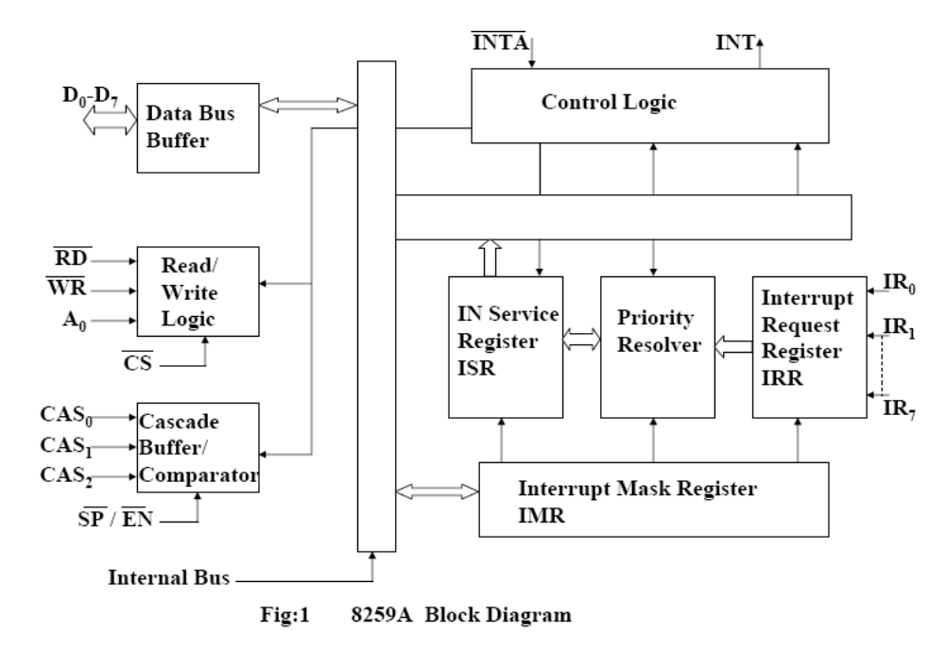
Internal Block Diagram of 8259A

Slide 47
The data bus allows the 8086 to send control words to the 8259A and read a status word from the 8259A
The RD and WR inputs control these transfers when the device is selected by asserting its chip select CS input low
The 8 bit data bus also allows the 8259A to send interrupt types to the 8086

Slide 48
If the 8259A is properly enabled, an interrupt signal applied to any one of the inputs IR0 – IR7 will cause the 8259A to assert its INT output pin high
If this pin is connected to the INTR pin of an 8086 and if the 8086 interrupt flag is set, then this high signal will cause the INTR response

Slide 49
The INTA input of the 8259A is connected to the INTA output of the 8086
The 8259A uses the first INTA pulse from the 8086 to do some activities that depend on the mode in which it is programmed
When it receives the second INTA pulse from the 8086, the 8259A outputs an interrupt type on the 8-bit data bus

Slide 50
It sends the 8086 a specified interrupt type for each of the eight interrupt inputs
The IR0 input has the highest priority, the IR1 input the next highest, and so on down to IR7, which has the lowest priority
If two interrupt signals occur at the same time, the 8259A will service the one with the highest priority first, assuming that both inputs are unmasked (enabled) in the 8259A

Slide 51
The Interrupt Mask Register (IMR) is used to disable (mask) or enable (unmask) individual interrupt inputs
Each bit in this register corresponds to the interrupt input with the same number
We can unmask an interrupt input by sending a command word with a 0 in the bit position that corresponds to that input

Slide 52
The Interrupt Request Register keeps track of which interrupt inputs are asking for service
If an interrupt input has an interrupt signal on it, then the corresponding bit in the interrupt request register will be set

Slide 53
The In-Service Register keeps track of which interrupt inputs are currently being serviced
For each input that is currently being serviced, the corresponding bit will be set in the In-Service Register

Slide 54
The Priority Resolver acts as a “judge” that determines if and when an interrupt request on one of the IR inputs gets serviced

Slide 55
Cascade Buffer/Comparator :
This block stores and compares the ID’s all the 8259A used in system
The three I/O pins CASO-2 are outputs when the 8259A is used as a master
The same pins act as inputs when the 8259A is in slave mode

Slide 56
CAS0 – CAS2 Cascade Lines:
A signal 8259A provides eight vectored interrupts
If more interrupts are required, the 8259A is used in cascade mode
In cascade mode, a master 8259A along with eight slaves 8259A can provide up to 64 vectored interrupt lines
These three lines act as select lines for addressing the slave 8259A

Slide 57
The device 8259A can be interfaced with any CPU using either Polling or Interrupt
In polling, the CPU keeps on checking each peripheral device in sequence to ascertain if it requires any service from the CPU
If any such service request is noticed, the CPU serves the request and then goes on to the next device in sequence

Slide 58
After all the peripheral device are scanned as above the CPU again starts from first device
This type of system operation results in the reduction of processing speed because most of the CPU time is consumed in polling the peripheral devices

Slide 59
In the interrupt driven method, the CPU performs the main processing task till it is interrupted by a service requesting peripheral device
The net processing speed of these type of systems is high because the CPU serves the peripheral only if it receives the interrupt request

Slide 60
Programming the 8259A…

Slide 61
The 8259A is programmed by initialization and operation command words
Initialization command words (ICWs) are programmed before the 8259A is able to function in the system
Operation command words (OCWs) are programmed during the normal course of operation and allow the 8259A to function properly

Slide 62
Initialization Command Words (ICWs)
The command words are sent to an 8259A to initialize it
According to the flow chart given in next slide, an ICW1 and an ICW2 must be sent to any 8259A in the system
If the system has any slave 8259As (cascade mode), then an ICW3 must be sent to the master and a different ICW3 must be sent to the slave
If the system is an 8086 or if you want to specify certain conditions then you have to send ICW4 to the master and to each slave

Slide 63
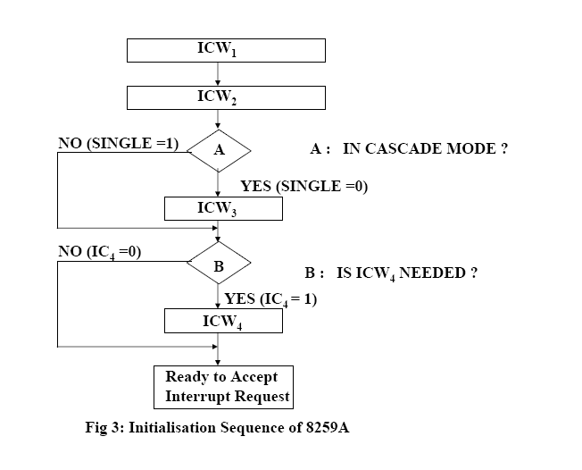

Slide 64
The 8259A must be initialized by writing two to four command words into the respective command word registers
These are called as initialized command words
It contains the control bits for edge/level triggered mode, single/cascade mode, call address interval and whether ICW4 is required or not

Slide 65
ICW 1 format
If A0 = 0 and D4 = 1, the control word is recognized as ICW1.
A0 bit is not a part of actual command word . It tells you the internal address that the command word must be sent to.
Least significant bit of ICW1 D0 bit tells the 8259A whether it needs to look for an ICW4 or not.
Since we are using the device in 8086 system we need to send ICW4. therefore make D0 as 1.

Slide 66
ICW1 selects single or cascade operation by programming the SNGL (D1)bit
If cascade operation is selected, we must also program ICW3
The LTIM(D3) bit determines whether the interrupt request inputs are positive edge-triggered or level-triggered
The bit D4 has to be 1.
For operation in 8086 bits D5, D6 and D7 are don’t cares so we make them as 0.

Slide 67
ICW2 format
If A0=1, the control word is recognized as ICW2. The ICW2 stores details regarding interrupt vector addresses
ICW2 is used to tell the 8259 the type number to send in response to an interrupt ssignal on the IR0 input.
Because 8086 interrupts type through 0 to 31 are either reserved or dedicated type 32 is the lowest type number available for us to use.
If we send ICW2 of 00100000 binary or 32 decimal The 8259 will send this number as the type to 8086
For example, if we decide to program the 8259A so that it functions at vector locations 08H – 0FH, we place a 08H into this command word

Slide 68
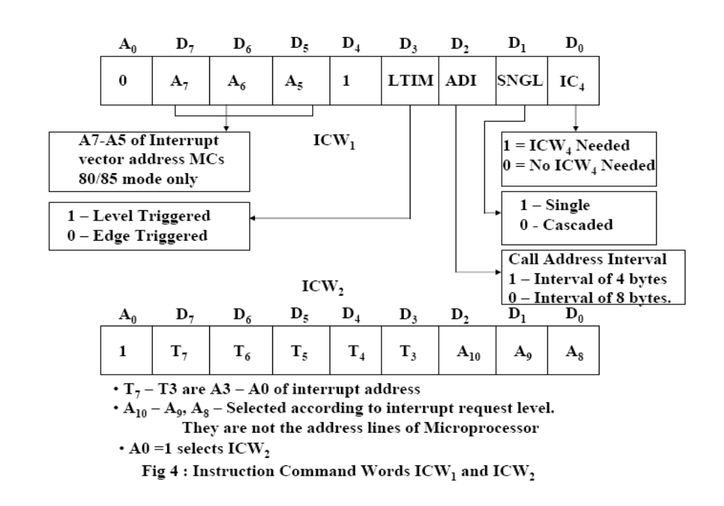

Slide 69
Once ICW1 is loaded, the following initialization procedure is carried out internally
  The edge sense circuit is reset, i.e. by default 8259A interrupts are edge sensitive
  IMR is cleared
  IR7 input is assigned the lowest priority
  Slave mode address is set to 7
  Special mask mode is cleared and status read is set to IRR
  If IC4 = 0, all the functions of ICW4 are set to zero Master/Slave bit in ICW4 is used in the buffered mode only

Slide 70
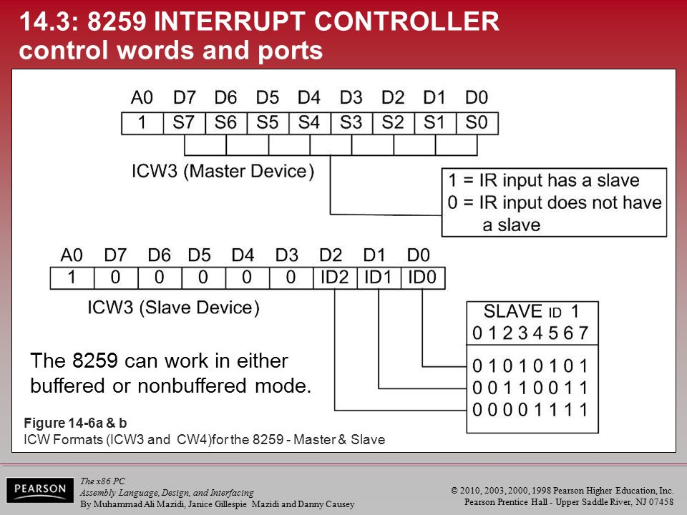

Slide 71
ICW3 format for both slave and master
ICW3 is used only when ICW1 indicates that the system is operated in cascade mode
This ICW indicates where the slave is connected to the master
Suppose we have two slaves connected to a master using IR0 and IR1
The master is programmed with an ICW3 of 03H; one slave is programmed with an ICW3 of 01H and the other with an ICW3 of 02H

Slide 72
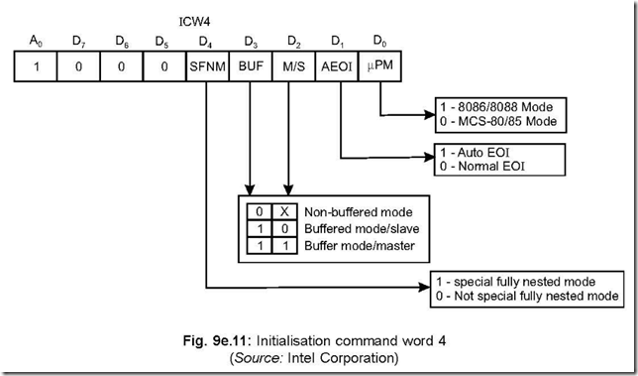

Slide 73
ICW4 format
ICW4 is programmed for use with the 8086 – Pentium Pro microprocessor
This ICW is not programmed in a system that functions with the 8085 microprocessors
The rightmost bit must be a logic 1 to select operation with the 8086 – Pentium Pro microprocessors and the remaining bits are programmed as follows:

Slide 74
SFNM – Selects the Special Fully Nested Mode of operation for the 8259A if a logic 1 is placed in this bit
This allows the highest priority interrupt request from a slave to be recognized by the master while it is processing another interrupt from a slave
Normally, only one interrupt request is processed at a time and others are ignored until the process is complete

Slide 75
BUF and M/S – Buffer and master slave are used together to select buffered operation or non buffered operation for the 8259A as a master or slave
If M/S is 1, 8259A is a master
If M/S is 0, 8259A is a slave
If BUF = 0, M/S to be neglected

Slide 76

AEOI – Selects automatic or normal end of interrupt
If AEOI is 1, the automatic end of interrupt mode is selected

Slide 77
OPERATION COMMAND WORDS (OCWS)
After the Initialization Command Words (ICWs) are programmed into the 8259A, the chip is ready to accept interrupt requests at its input lines.
However, during the 8259A operation, a selection of algorithms can command the 8259A to operate in various modes through the Operation Command Words (OCWs).

Slide 78
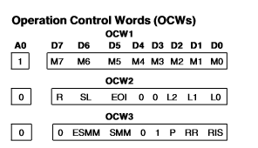

Slide 79
Operation Control Word 1 (OCW1)
OCW1 sets and clears the mask bits in the interrupt Mask Register (IMR).
M7–M0 represent the eight mask bits.
M = 1 indicates the channel is masked (inhibited),
M = 0 indicates the channel is enabled

Slide 80
Operation Control Word 2 (OCW2)
OCW2 is mainly used to reset the bit in in-service register.
R, SL, EOI These three bits control the Rotate and End of Interrupt modes and combinations of the two.
for the corresponding slave

Slide 81
End of Interrupt (EOI )
The In Service (IS) bit can be reset either automatically following the trailing edge of the last in sequence INTA pulse (when AEOI bit in ICW1 is set) or by a command word that must be issued to the 8259A before returning from a service routine (EOI command).
An EOI command must be issued twice if in the Cascade mode, once for the master and once

Slide 82
There are two forms of EOI command: Specific and Non-Specific
Specific EOI : When the 8259A is operated in modes which preserves the fully nested structure, it can determine which IS bit to reset on EOI.
When a Non Specific EOI command is issued the 8259A will automatically reset the highest IS bit of those that are se

Slide 83
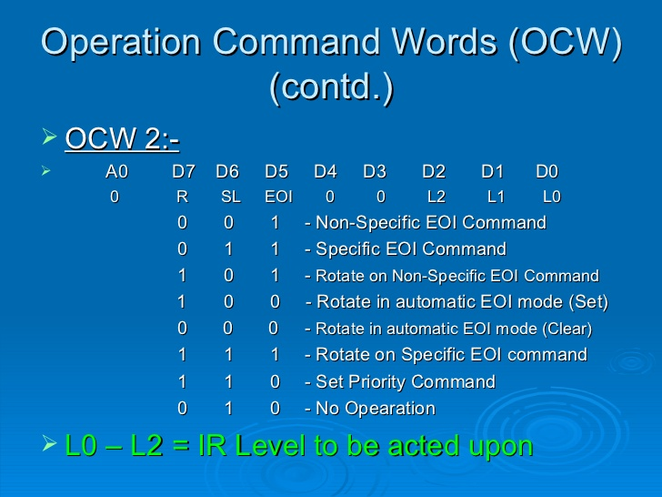


Slide 84
Fully Nested Mode
This mode is entered after initialization unless another mode is programmed.
The interrupt requests are ordered in priority from 0 through 7 (0 highest).
When an interrupt is acknowledged the highest priority request is determined and its vector placed on the bus. Additionally, a bit of the Interrupt Service register (ISO-7) is set.
This bit remains set until the microprocessor issues an End of Interrupt (EOI) command immediately before returning from the service routine,
or if AEOI (Automatic End of Interrupt) bit is set, until the trailing edge of the last INTA. While the IS bit is set, all further interrupts of the same or lower priority are inhibited,

Slide 85
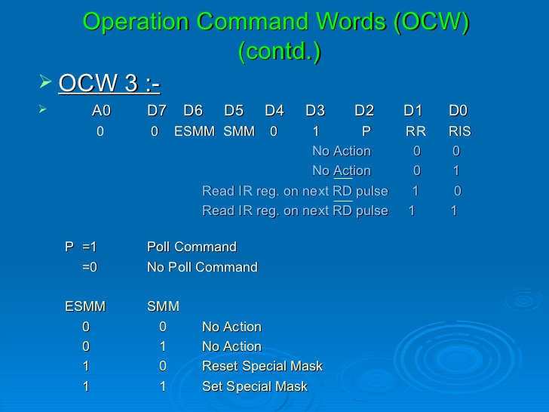

Slide 86
Thank You…

